Slide 1
Introduction to Architecture Simulation
Shin-haeng Kang
shkang@iris.snu.ac.kr
2016-03-15

Slide 2
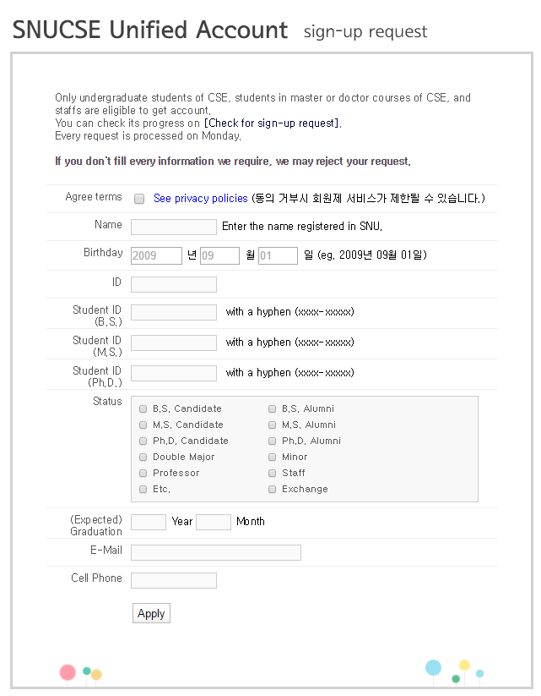
SNUCSE Unified Account
http://www.snucse.org/Account/JoinForm.aspx

Slide 3
Agenda
Why simulator?
Terminologies
Timing model
SystemC basic

Slide 4
Why simulator?

Slide 5
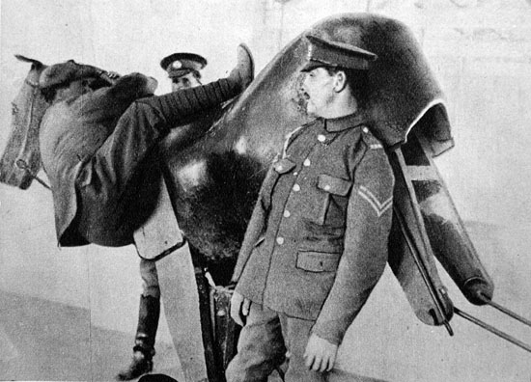
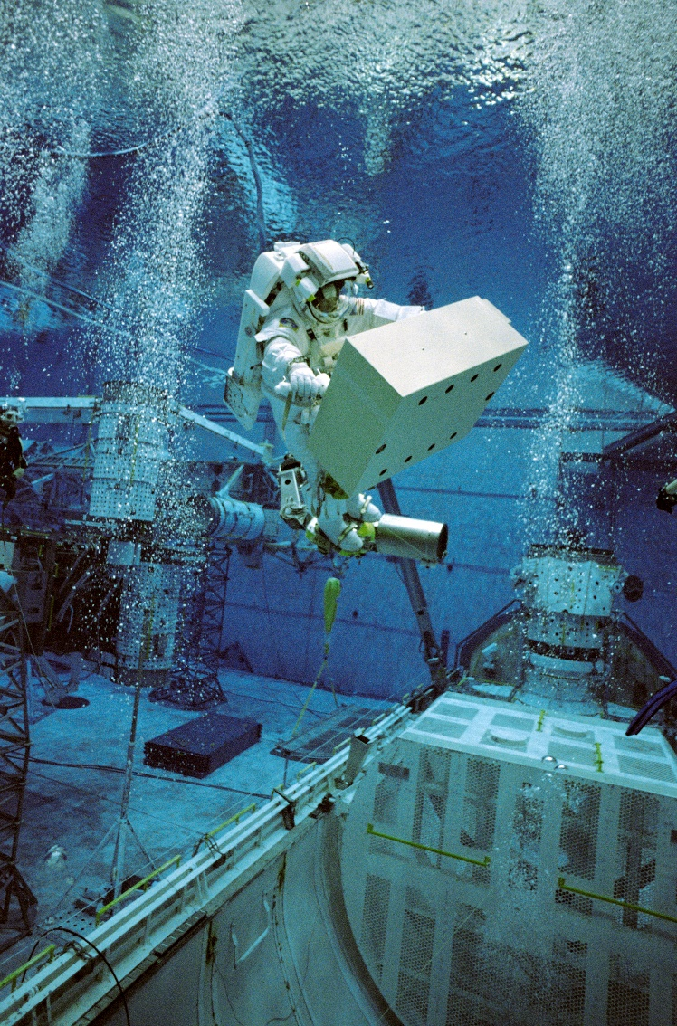

Simulation?
Imitation of the operation of a real-world process or system
simulation of technology, safety engineering, testing, training, education, and video games
Need to build an appropriate simulation model.
To represent the key characteristics or behaviors/functions of the selected system and process.

Slide 6
Architecture Simulation
Design tomorrow’s architecture using today’s architecture
The most important tool available to computer architecture researchers
Purpose
Obtain performance characteristics for new architectures
Architectural exploration
Early software development/optimization

Slide 7
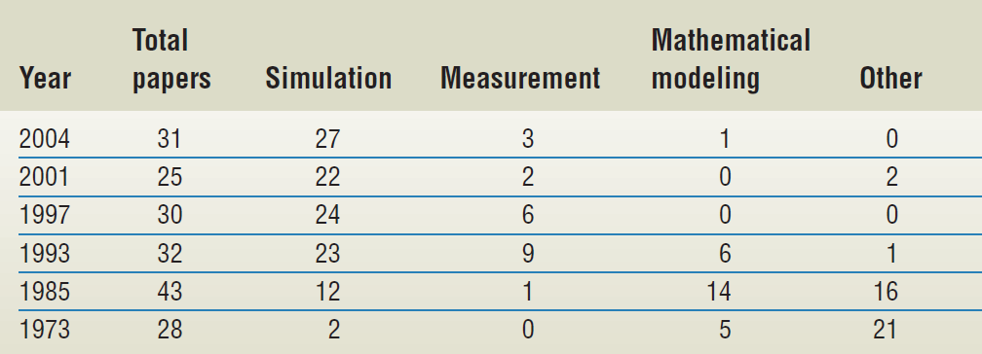
1) Performance evaluation
Performance evaluation methodologies in papers appearing in the Proceedings of the International Symposium on Computer Architecture
87%
88%
27.9%

Slide 8
2) Architecture exploration
Find the optimal configuration
Decision space
Objective space
Power consumption
Cache line size
Simulation
Associativity
Cache set size
Cache miss ratio

Slide 9
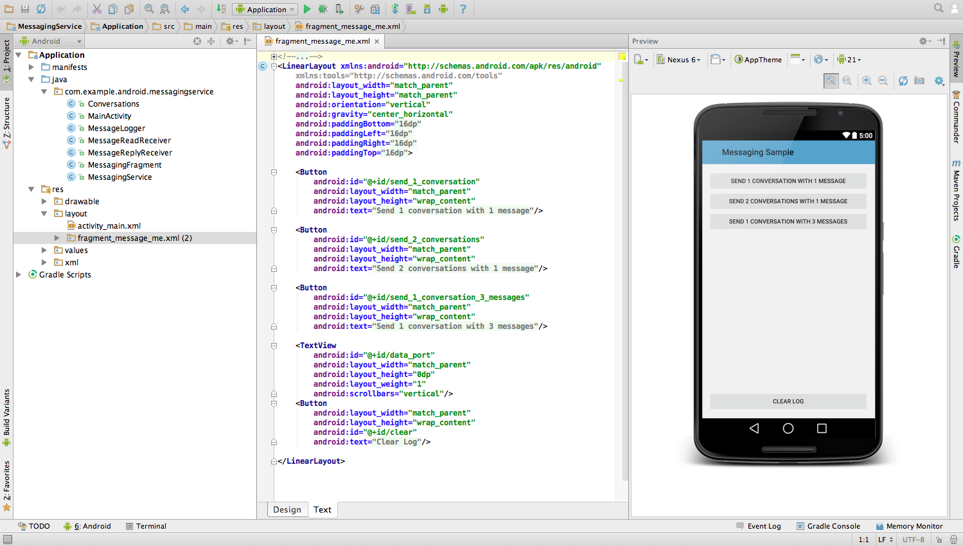
3) Early software development/optimization
Simulators let you prototype, develop and test applications without using a physical device.
Example) A virtual mobile device emulator for Android
mimics all of the hardware and software features of a typical mobile device, except that it cannot place actual phone calls

Slide 10
Terminologies

Slide 11
Host and target
Simulation host, simulation target
Simulation host: the system executing simulation.
Simulation target: the system being simulated.
Ex ) The definition of Architecture simulation: to design tomorrow’s architecture using today’s architecture
Simulation time, simulated time
Simulation time:
Consumed during the computation of the simulation (wallclock time)
Simulated Time
Simulated within the simulation
example) it takes 1000s (simulation time) on the simulation host to simulate 1s (simulated time) of the simulation target
Simulation target
Simulation host

Slide 12
Cross-compile
Definition: creating executable code for a simulation target system on which the compiler is running (=host system)
Creating ARM-executable binary on an x64 ubuntu machine
[shkang@ubuntu example]$ arm-gcc -o hello_world hello_world.c
[shkang@ubuntu example]$ ./hello_world
-bash: ./hello_world: cannot execute binary file: Exec format error
[shkang@ubuntu example]$ tqsim hello_world
Hello world! I am an arm binary
------------------------------------------------------
-----------------Statistics---------------------------
------------------------------------------------------
Total commited inst : 12049
Estimated execution cycle : 37945
Cache il1] num_access: 2124 / num_miss: 303
Cache dl1] num_access: 4777 / num_miss: 185
Cache ul2] num_access: 488 / num_miss: 453
Bpred] num_lookups: 2822 / num_misses: 475
Cross-compile
Simulation

Slide 13
Simulation categories (1)
Scope
Instruction set simulator: can model a target microprocessor only
Full system simulator: can model an entire computer system including a processor, a memory system, and I/O devices.
Focus
Functional simulation
Generates correct program output
Validate only functional requirements
Timing simulation
captures the timing of events to obtain program execution time

Slide 14
Simulation categories (2)
Input (workload)
Trace-driven (event-driven): Simulator reads a “trace” of instructions captured during a previous execution
Trace = time ordered record of events on real system
Execution-driven: Simulator “runs” the program
2 408ed4
0 10019d94
2 408ed8
1 10019d88
2 408edc
0 10013220
2 408ee0
2 408ee4
1 100230b8
2 408ee8
0 10013220
2 408eec
2 408ef0
2 408ef4
1 10013220
2 408ef8
1 100230bc
2 408efc
Trace-based
Cache
Simulator
./dineroIV -l1-isize 16384 -l1-iassoc 4 -l1-ibsize 32 -l1-irepl l -l1-dsize 32768 -l1-dassoc 2 -l1-dbsize 16 -l1-drepl f -l1-dwalloc a -l1-dwback a -informat d < cc1.din > sample.out

Slide 15
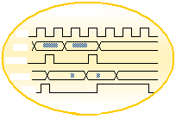
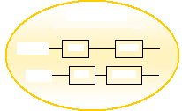
Simulation categories (3)
Abstraction level
RTL (Register Transfer Level)
TLM (Transaction Level Modeling)
abstracts communication
RTL
TLM
RTL module
Functional Module
CLK
Pin_0 = 1
Pin_1 = 0
Pin_2 = 0
……
ADDR
write(addr, data)
MEMORY
Read
Write
EN
DATA
CPU
Load
Execute
nRW
RTL module
Functional Module

Slide 16
Instruction set simulator (ISS)
Based on the instruction set architecture
Implemented in high level languages like C++
Modeling the behavior of microprocessors
Reading instructions and maintaining internal variables which represent the processor's registers.
Categories
Interpretive ISS
Compiled ISS
Static
Dyanmic

Slide 17
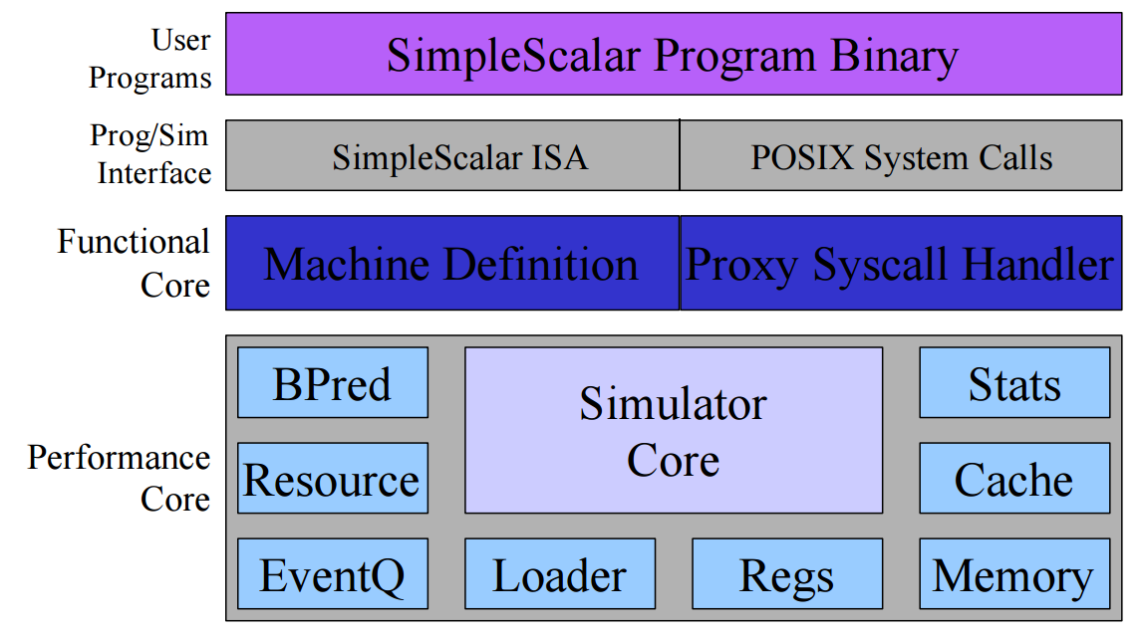
Interpretive ISS
Interpret an instruction one by one
Mimics the microarchitecture pipeline
Flexible & Accurate
Working in the similar way to the processor behavior
Easy to implement, easy to estimate performance
Slow
ruu_init()
for (;;) {
ruu_commit();
ruu_writeback();
lsq_refresh();
ruu_issue();
ruu_dispatch();
ruu_fetch();
}
Simplescalar’s main function
Simplescalar’s structure

Slide 18
Statically Compiled ISS
Simulation compiler compiles the target binary to produce a C code to be executed on the host machine: reduce decoding time.
Fast
Cannot support dynamic program code
Self-modifying code, external code (loading), dynamic linking library, and multiple instruction set (ARM:Thumb)
Large memory space
Target Code
Target Cross-Compiler
C Code generation
Host C-compiler
Host executable Code
Target Binary
C code

Slide 19
Dynamic binary translation (DBT)
A runtime conversion of the target CPU instructions into the host instruction set.
Relative slow
Flexible and relatively accurate
Ex) QEMU
False
Cache hit?
Hit
Binary Trans lation
Translation Cache
Target Binary
Inst Fetch
Execution
QEMU emulation flow

Slide 20
Dynamic binary translation (DBT)
Arm binary
(target binary)
0x00008d0c: e92d4800 push {fp, lr}
mov_i32 tmp5,r13
movi_i32 tmp6,$0xfffffffffffffff8
add_i32 tmp5,tmp5,tmp6
mov_i32 tmp6,r11
qemu_st_i32 tmp6,tmp5,leul,$0x0
……
Intermediate code
0x7f56b63fba10: mov -0x4(%r14),%ebp
0x7f56b63fba14: test %ebp,%ebp
0x7f56b63fba16: jne 0x7f56b63fbaba
0x7f56b63fba1c: mov $0x9380,%ebp
0x7f56b63fba21: mov %gs:0x0(%rbp),%ebp
0x7f56b63fba25: mov %ebp,0x8(%r14)
0x7f56b63fba29: mov %gs:0x0(%rbp),%ebp
…
x64 binary
(host binary)

Slide 21
Timing model
Cycle-accurate simulation
k-CPI simulation
Analytical simulation
Sampled simulation
Statistical simulation
FPGA-accelerated simulation

Slide 22
Cycle-accurate simulation
Simulates a microarchitecture on a cycle-by-cycle basis
Update the system state every cycle
Slow
10 – 100 KIPS (kilo simulated instructions per second)
240 GIPS
Intel Core i7 5960X
100 KIPS
i7 Simulator
To simulate 1s
240,000s is required
1.82 year

Slide 23
k-CPI simulation
it takes k cycles to execute one instruction
The number of cycles is given
By one cycle for all instructions (1-CPI model)
According to the datasheet of the simulated processor (datasheet model)
Fastest but inaccurate
Ex) Imperas OVP and ARM FastModels

Slide 24
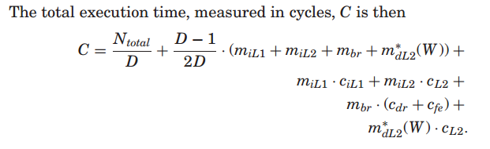
Analytical simulation
Estimates the processor performance by using mathematical formulas
How construct a model?
Mechanistic model: based on the mechanics of the target processor
White-box modeling
Empirical model: by machine learning or regression analysis
Black-box modeling

Slide 25

Sampled simulation
performs cycle-accurate simulation with sampling units rather than the entire instruction streams
Sampling units are selected
randomly
periodically
based on phase analysis

Slide 26

Statistical simulation
Uses generated short-running synthetic traces or benchmarks that are representative for long-running benchmarks
Statistics collection phase
Base program characteristics: basic instruction mix and instruction dependency
Micro-architectural dependent statistics: cache, branch statistics
Synthetic simulator phase
Feed a synthetic instruction trace to a simple processor model

Slide 27
FPGA-accelerated simulation
Implements timing models onto field-programmable gate-arrays (FPGA)
Demands an additional hardware and development time to synthesize the model into hardware

Slide 28
Conclusion
Speed
Accuracy

Slide 29
SystemC

Slide 30
SystemC
A set of C++ classes and macros to support system-level design
Motivation
Even Verilog or VHDL’s behavioral modeling is not high-level enough
People generally use C or C++
Developed by OSCI (Open systemC initiative)
Open-source
http://accellera.org/downloads/standards/systemc
Support both TLM and RTL modeling
Does not have to use multiple languages to use multiple level of abstractions.

Slide 31
SystemC supports
Concurrency
Concurrent processes can be described using plain C++ syntax
Timing
Clocks are special signals that run periodically and trigger clocked processes
Rich set of data types for HW

Slide 32
SystemC design methodology
Manual Translation
(Error-prone)
SystemC Model
C, C++ System-level
Model
Verilog/VHDL
Simulation
Analysis
Simulation
Refinement
Results
Synthesis
Synthesis
Previous design methodology
SystemC-based methodology

Slide 33
Introductory Example
Module
Testbench
Counter
Port
Reset
Go
value
Channel
process
do_count
Clock

Slide 34
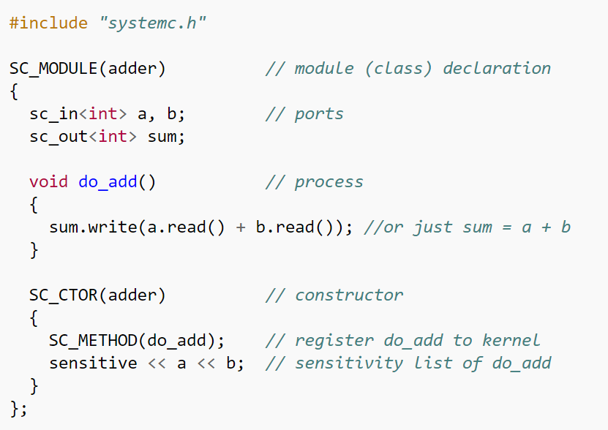
Module
Basic Unit of Design
Hierarchical Entity
Syntax
SC_MODULE(module_name) {
/* port declaration */
/* local channel(signal) declaration */
/* variable declaration */
/* process declaration */
/* other method declaration */
/* submodule declaration */
/* constructor */
SC_CTOR(module_name) {
/* module instantiation and channel binding */
/* process registration */
/* sensitivity list */
/* module variable initialization */
}
}

Slide 35
Ports (pin-level)
Define the interface to each module
Three types of ports depending on the direction
Input: sc_in
Output: sc_out
Bidirectional: sc_inout
Member functions
read(): read the current value
write(value): write a new value
event(), pos()/neg()
Syntax
sc_in{out,inout}<data_type> port_name;
ex) sc_in<bool> clk, reset, go;

Slide 36
Processes
 | SC_METHOD | SC_THREAD | SC_CTHREAD
Infinite loop | No | Yes | Yes
construct | SC_METHOD(pro) sensitive(sig); sensitive_pos(sig); semsitive_neg(sig); | SC_THREAD(pro); sensitive(sig); sensitive_pos(sig); semsitive_neg(sig); | SC_CTHREAD(pro, clock.pos()); SC_CTHREAD(pro. clock,neg());
suspend | NA | wait() | wait(); wait(n*);
local variable | lost | saved | saved
Static sensitivity | signal events | signal events | clock edge
Dynamic sensitivity | next_trigger(ev); | wait(ev) | wait_until(exp); watching(exp);
Usage | Comb. logic | Behavior, test bench | FSM

Slide 37
Sensitivity List
Determine when to trigger the process
Static sensitivity: defined in SC_CTOR
sensitive << event [<< event]…; //streaming style
sensitive(event [, event]…); //functional style
Dynamic sensitivity: defined inside the process definition
SC_METHOD: next_trigger(event)
SC_THREAD: wait(event)
SC_CTHREAD: wait_until(expression)
SC_CTHREAD: watching(expression)
Defined on process registration to restart the process when the expression is met.

Slide 38
Timing in SystemC
Time in SystemC
units: SC_SEC, SC_MS, SC_US, SC_NS, SC_PS, SC_FS
“sc_time” class defines a time object (ex) sc_time t(15, SC_NS)
Define the time unit
sc_set_default_time_unit(1, SC_NS): set the default time unit
sc_set_time_resolution(1,SC_NS): set the default time resolution
The default is SC_PS if omitted
Keep track of the current simulation time: cout << sc_time_stamp()<<endl;
Clock
The only thing in SystemC that has a notion of real time
sc_clock name(“name”, period, duty_cycle, first, rising) or sc_clock name(“name”, period, time_unit, duty_cycle, first, first_time_unit, rising)
first: time elapsed until encounters the first edge
rising: set “TRUE” if the first edge is rising or “FALSE” if falling

Slide 39
Channels (1)
SystemC has two types of channel : primitive and hierarchical
Primitive channels
Contains no hierarchy, no processes.
Designed to be very fast due to their simplicity.
sc_signal, sc_buffer, sc_mutex, sc_fifo, sc_semaphore
module
module
Channel
channel
process
process
process
interface
interface
port
interface

Slide 40
Channels (2)
Both supports 1 writer & multiple readers
Basic methods
read(), write(), delayed(), event(), etc
Evaluate-update protocol
New value is visible after the current process is suspended
Difference
sc_buffer generates an event at every write() while sc_signal generates an event only when the value is changed.
You will see the difference through the lab.

Slide 41
SystemC module (revisited)

Slide 42
Lab Notification
18th March, Friday
1-3 PM
Room 311-1, Building 302
Q) Do you have an SNUCSE Unified account?

